Slide 1
CSE251: Electronic Devices and Circuits
Lecture: 20 - 22 – BJT
Prepared By:
Yeasin Arafat Pritom (YAR)
Lecturer, Department of Computer Science and Engineering, School of Data and Sciences, BRAC University
Email: ext.yeasin.arafat@bracu.ac.bd

Slide 2
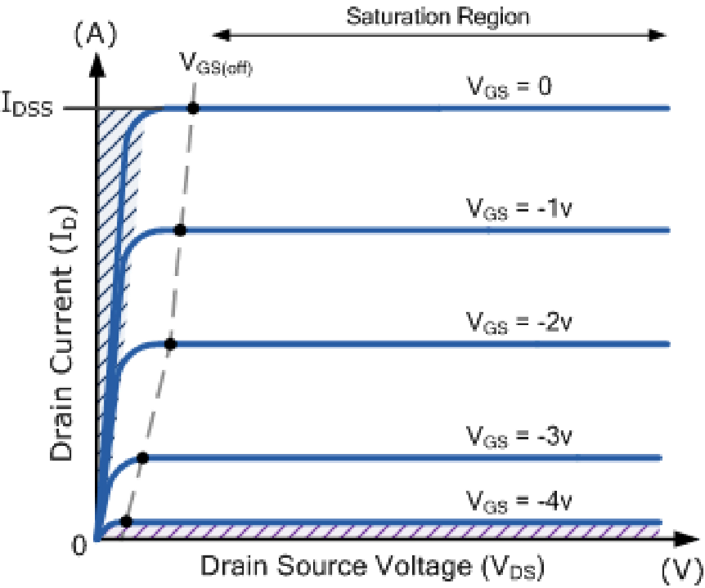
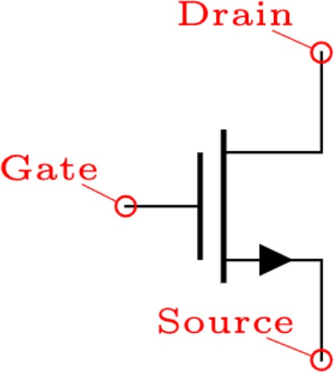
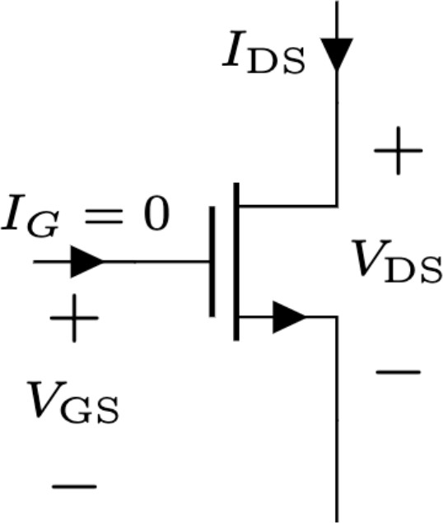
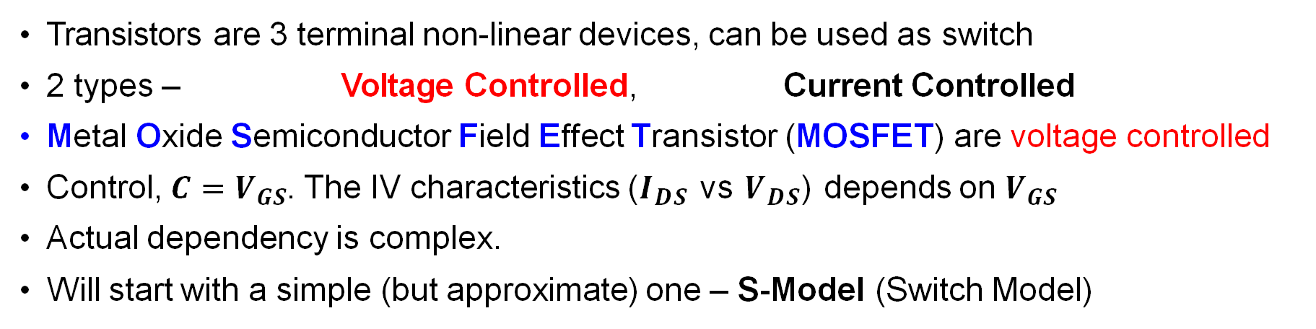
Transistors as Digital Switch
Transistors are 3 terminal non-linear devices, can be used as switch
2 types – Voltage Controlled, Current Controlled
Metal Oxide Semiconductor Field Effect Transistor (MOSFET) are voltage controlled
Control, $C=V_{GS}$. The IV characteristics ($I_{DS}$ vs $V_{DS}$) depends on $V_{GS}$
Actual dependency is complex.
Will start with a simple (but approximate) one – S-Model (Switch Model)

Slide 3
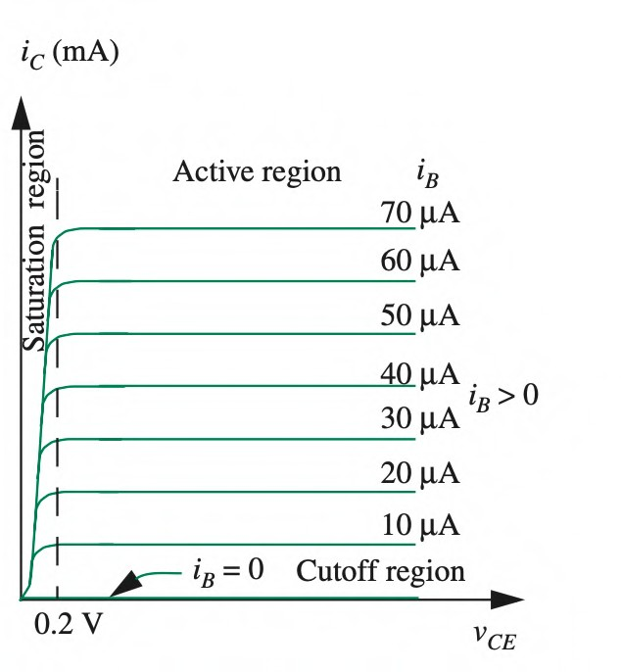
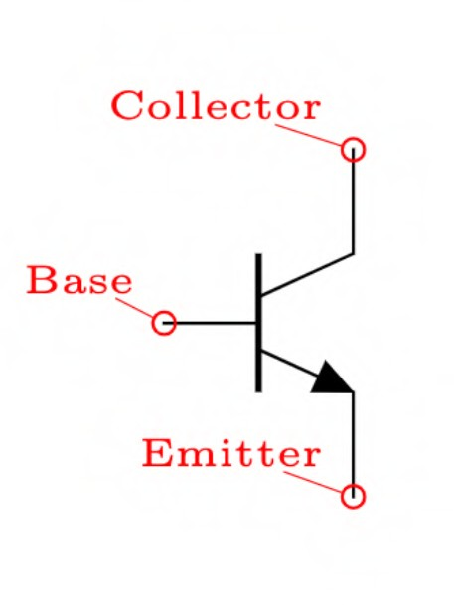
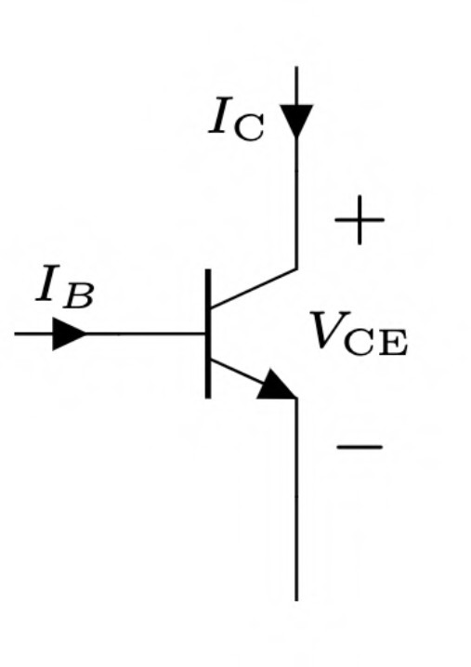
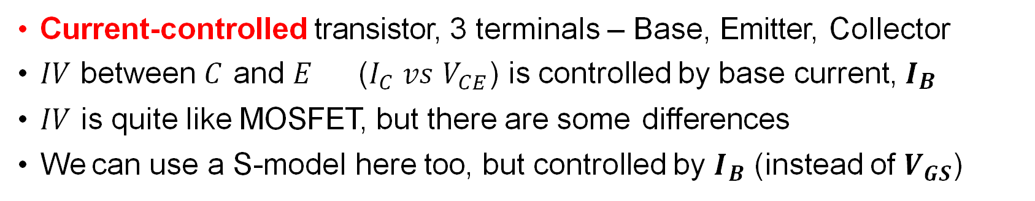
Bipolar Junction Transistor
Current-controlled transistor, 3 terminals – Base, Emitter, Collector
$IV$ between 𝐶 and 𝐸 ($I_{C}$ 𝑣𝑠 $V_{CE}$) is controlled by base current, 𝑰_{𝑩}
$IV$ is quite like MOSFET, but there are some differences
We can use a S-model here too, but controlled by $I_{B}$ (instead of $V_{GS}$)

Slide 4
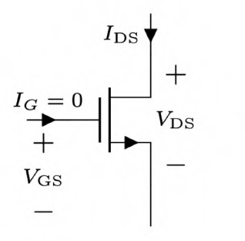
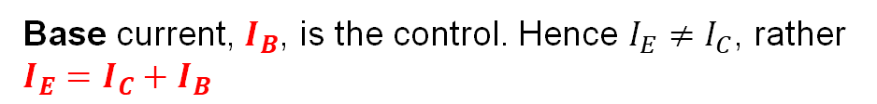


BJT vs MOSFET - Differences
BJT
MOSFET
Current controlled, $I_{B}$ controls ($I_{C}$ vs $V_{CE}$)
Voltage controlled, $V_{GS}$ controls ($I_{DS}$ vs $V_{DS}$)
Base current, $I_{B}$, is the control. Hence $I_{E}≠I_{C}$, rather $I_{E}=I_{C}+I_{B}$
Gate current, $I_{G}$, is always $0$. Hence $I_{S}=I_{D}=I_{DS}$.

Slide 5
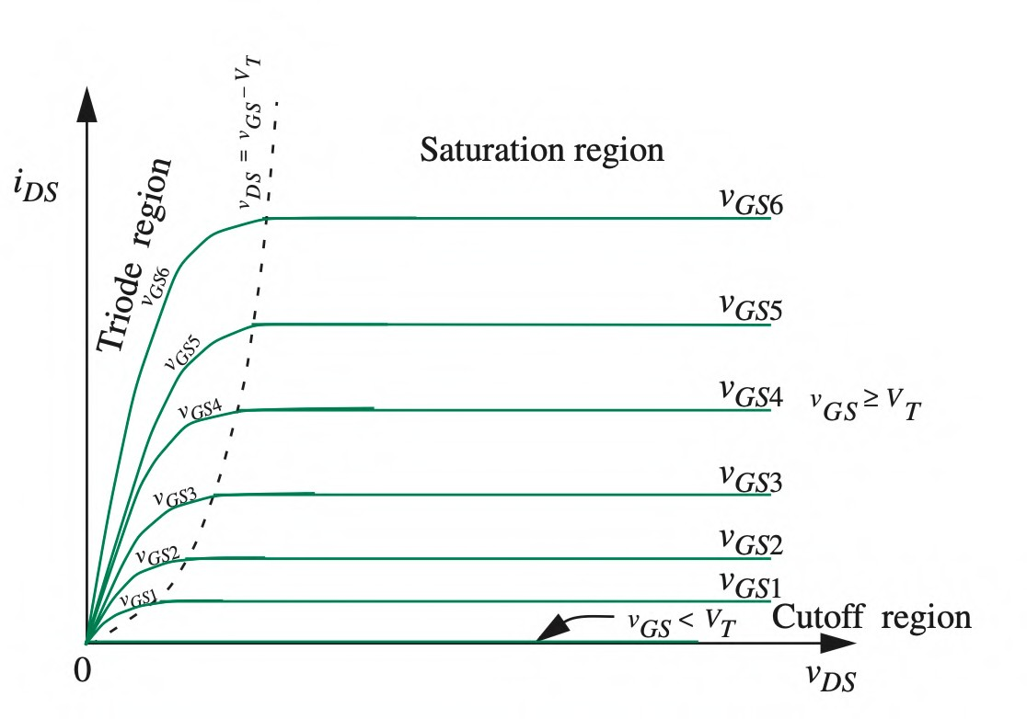
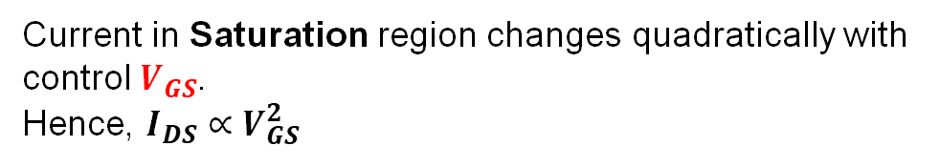
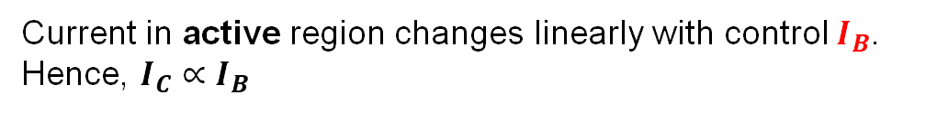
BJT vs MOSFET - Differences
BJT
MOSFET
Slope in the saturation region is HIGH, hence very small resistance when “ON”
Slope in the Triode region is LOW, hence significant resistance when “ON”
Current in Saturation region changes quadratically with control $V_{GS}$.
Hence, $I_{DS}∝V_{GS}^{2}$
Current in active region changes linearly with control $I_{B}$.
Hence, $I_{C}∝I_{B}$

Slide 6
BJT vs MOSFET - Differences
BJT
MOSFET
Slope in the saturation region is HIGH, hence very small resistance when “ON”
Slope in the Triode region is LOW, hence significant resistance when “ON”
Current in Saturation region changes quadratically with control $V_{GS}$.
Hence, $I_{DS}∝V_{GS}^{2}$
Current in active region changes linearly with control $I_{B}$.
Hence, $I_{C}∝I_{B}$

Slide 7
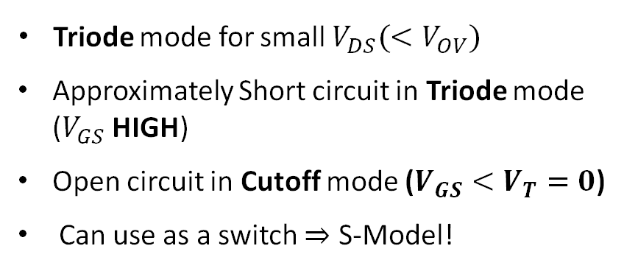
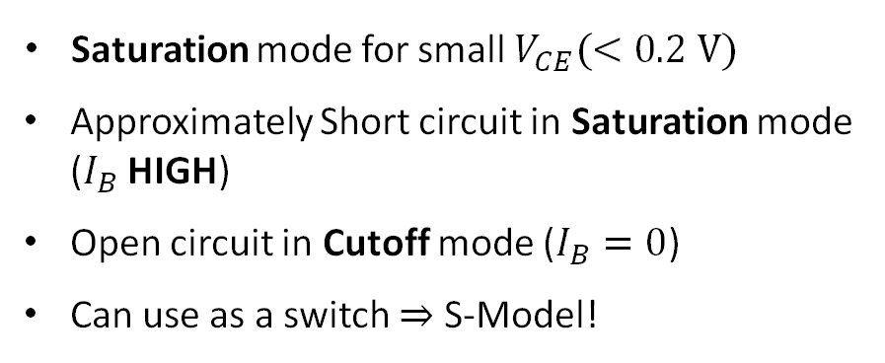
BJT vs MOSFET - Similarities
BJT
MOSFET
Saturation mode for small $V_{CE}(<0.2 V)$
Approximately Short circuit in Saturation mode ($I_{B}$ HIGH)
Open circuit in Cutoff mode ($I_{B}=0$)
Can use as a switch ⇒ S-Model!
Triode mode for small $V_{DS}(<V_{OV})$
Approximately Short circuit in Triode mode ($V_{GS}$ HIGH)
Open circuit in Cutoff mode ($V_{GS}<V_{T}=0$)
Can use as a switch ⇒ S-Model!

Slide 8
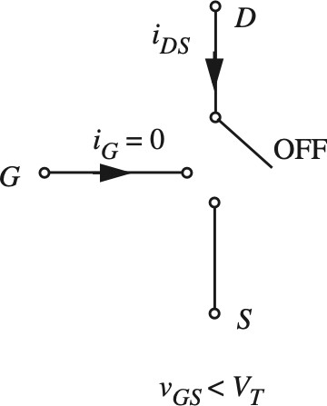
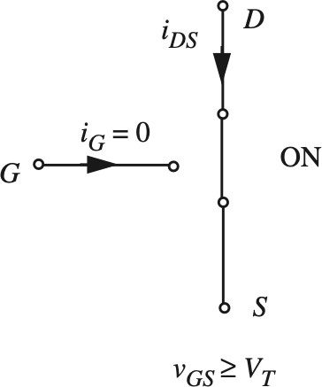
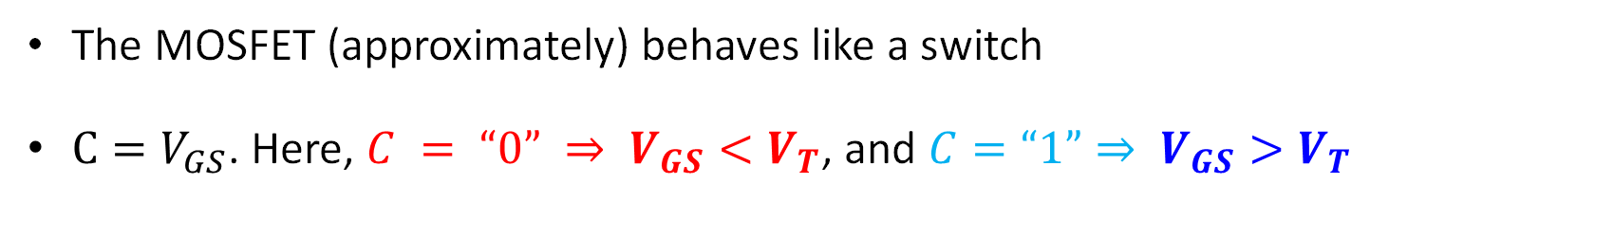
MOSFET S-Model
The MOSFET (approximately) behaves like a switch
$C=V_{GS}$. Here, $C = “0” ⇒ V_{GS}<V_{T}$, and $C=“1”⇒ V_{GS}>V_{T}$

Slide 9
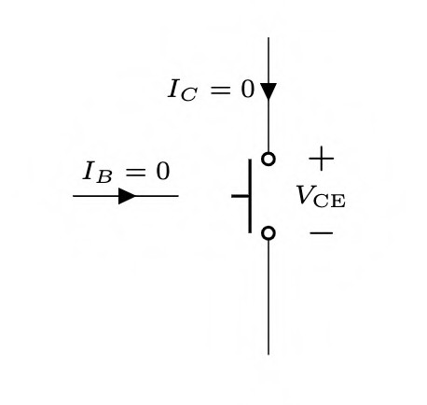
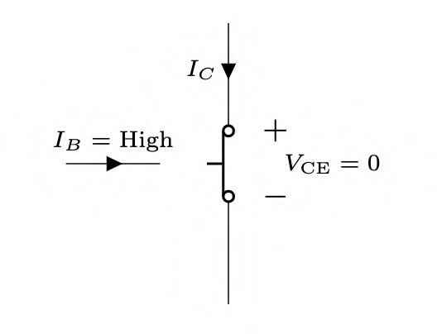



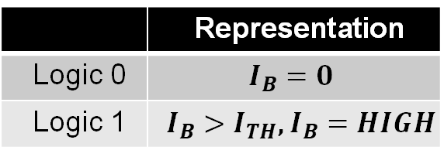

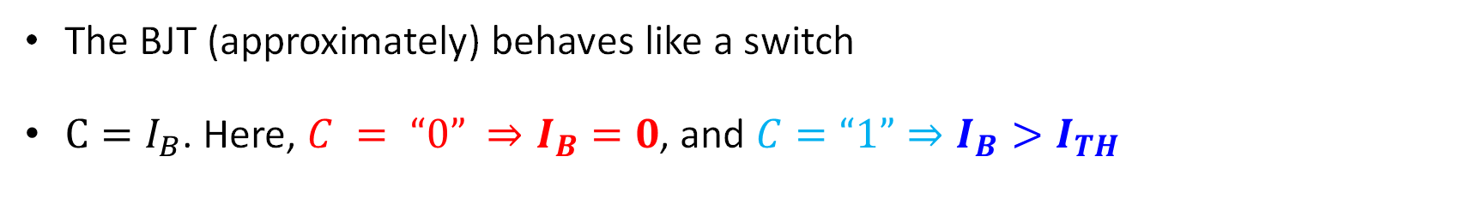


BJT S-Model
 | Representation
Logic 0 | $$I_{B}=0$$
Logic 1 | $I_{B}>I_{TH}$, $I_{B}=HIGH$
The BJT (approximately) behaves like a switch
$C=I_{B}$. Here, $C = “0” ⇒I_{B}=0$, and $C=“1”⇒I_{B}>I_{TH}$
$$I_{C}$$
$$I_{B}>I_{TH},$$
$V_{CE}=0$, short ckt
$$I_{B}=0$$
$I_{C}=0$, open ckt
$$V_{CE}$$

Slide 10
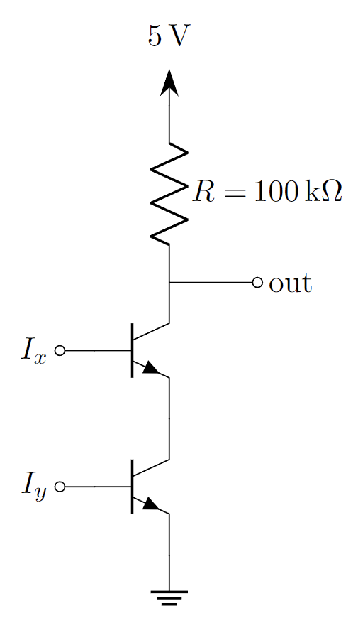
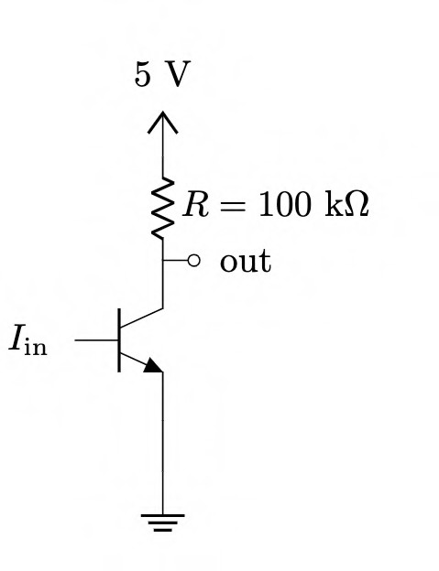
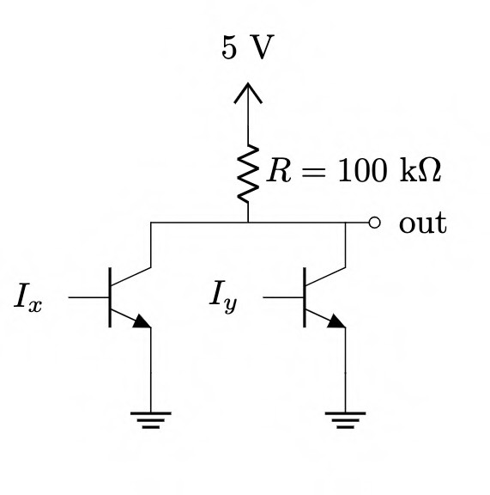
Current-Controlled Logic Gates using BJT
Just replace switches with BJTs!
Major problem: Cannot cascade! (Why?)
Input Logic Variable: Current
Output Logic Variable: Voltage
BJT Inverter (NOT Gate)
BJT NAND Gate
BJT NOR Gate

Slide 11
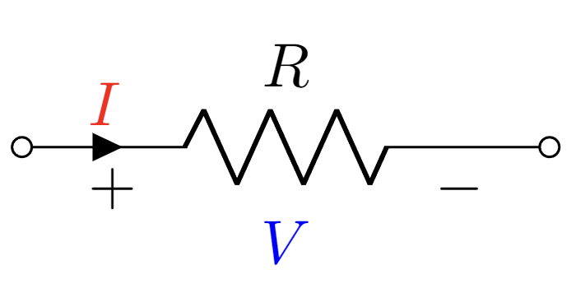
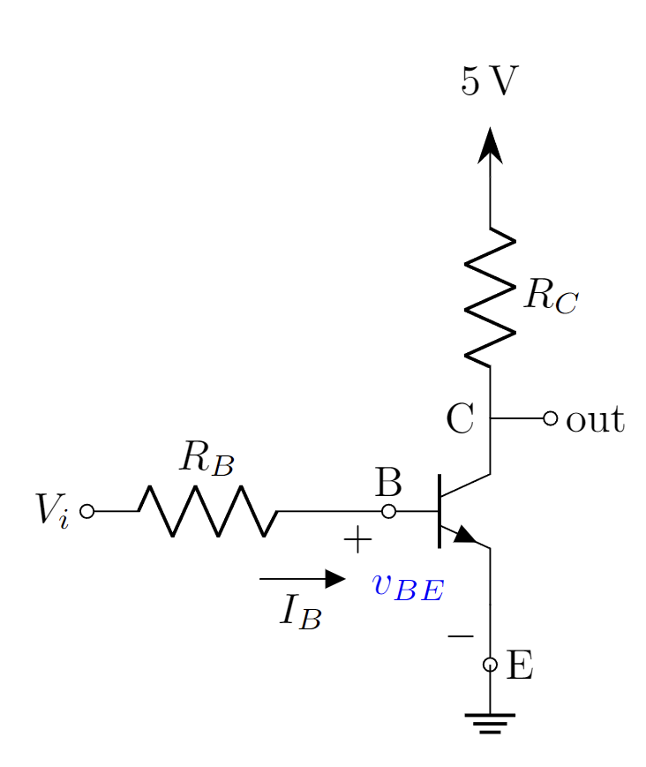
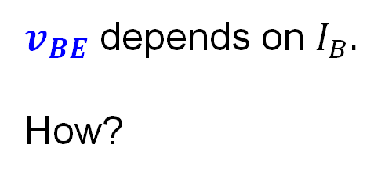
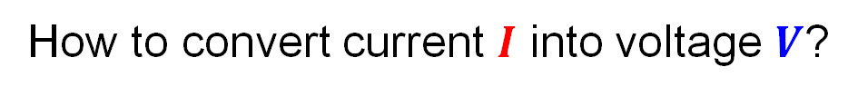
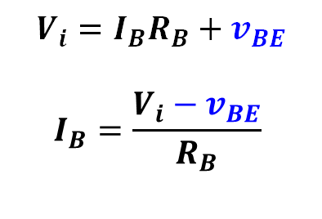
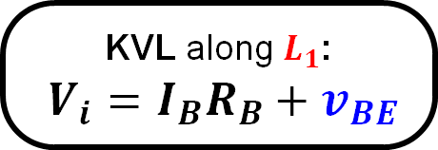

From Current Controlled to Voltage Controlled
How to convert current $I$ into voltage $V$?
$$V=IR$$
$$V_{i}=I_{B}R_{B}+v_{BE}$$
$$I_{B}=\frac{V_{i}−v_{BE}}{R_{B}}$$
$v_{BE}$ depends on $I_{B}.$
How?
KVL along $L_{1}$:
$V_{i}=I_{B}R_{B}+v_{BE}$

Slide 12




Logic Gates using BJT
Just replace switches with BJTs! – and add a Resistor to the Base terminal
Major problem: Cannot cascade! (Why?) Can be cascaded.
Input Logic Variable: Current Voltage
Output Logic Variable: Voltage
$$V_{x}$$
$$V_{x}$$
$$V_{y}$$
$$V_{y}$$
BJT Inverter (NOT Gate)
BJT NAND Gate
BJT NOR Gate

Slide 13
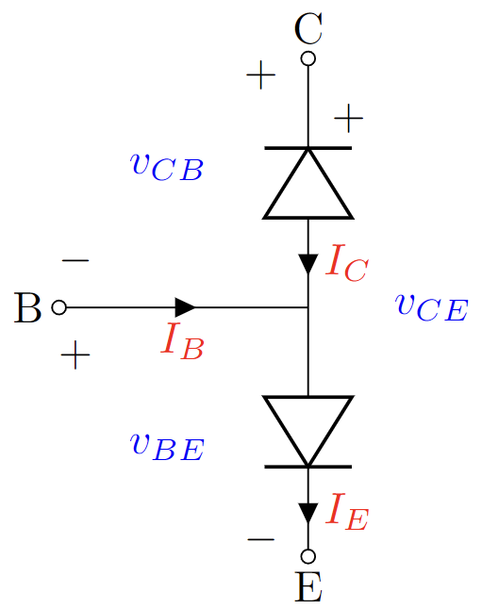
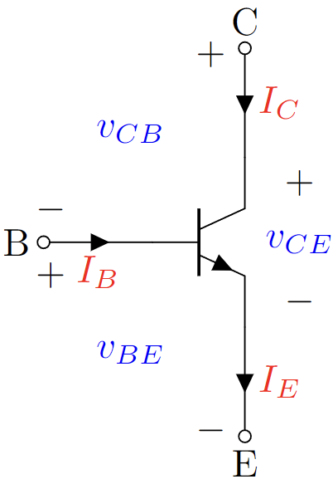
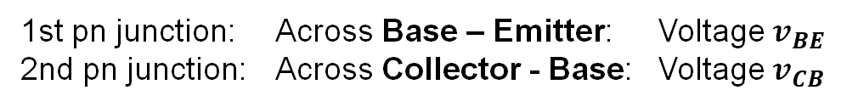



Parameters of BJT
A BJT can be thought of as two “pn” junctions placed back-to-back.
$+$
$v_{CB}$
$−$
$+$
$v_{CE}$
$−$
n
$+$
$v_{BE}$
$−$
p
n
1st pn junction: Across Base – Emitter: Voltage $v_{BE}$
2nd pn junction: Across Collector - Base: Voltage $v_{CB}$

Slide 14
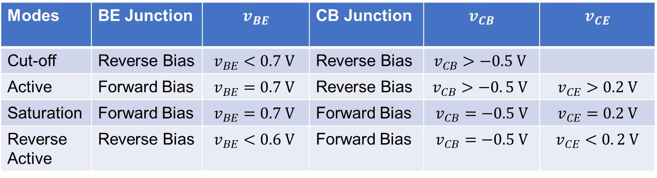
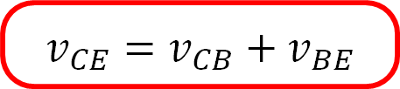
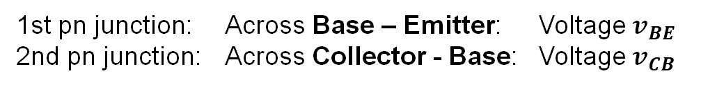
Parameters of BJT
A BJT can be thought of as two “pn” junctions placed back-to-back.
Modes | BE Junction | $$v_{BE}$$ | CB Junction | $$v_{CB}$$ | $$v_{CE}$$
Cut-off | Reverse Bias | $$v_{BE}<0.7 V$$ | Reverse Bias | $$v_{CB}>−0.5 V$$
Active | Forward Bias | $$v_{BE}=0.7 V$$ | Reverse Bias | $$v_{CB}>−0. 5 V$$ | $$v_{CE}>0.2 V$$
Saturation | Forward Bias | $$v_{BE}=0.7 V$$ | Forward Bias | $$v_{CB}=−0.5 V$$ | $$v_{CE}=0.2 V$$
Reverse Active | Reverse Bias | $$v_{BE}<0.6 V$$ | Forward Bias | $$v_{CB}=−0.5 V$$ | $$v_{CE}<0. 2 V$$
1st pn junction: Across Base – Emitter: Voltage $v_{BE}$
2nd pn junction: Across Collector - Base: Voltage $v_{CB}$
$$v_{CE}=v_{CB}+v_{BE}$$

Slide 15
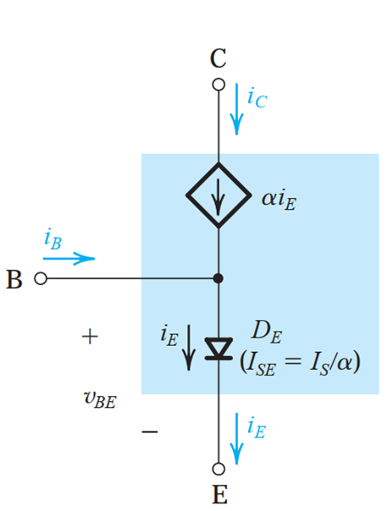

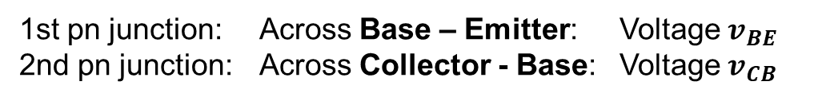
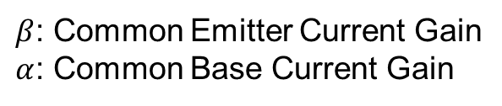

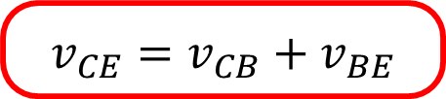
Parameters of BJT: Active Mode
Equivalent circuit of an npn-BJT in Active Mode
Current relationships between the three currents in an npn BJT.
$$I_{B}+I_{C}=I_{E}$$
$$I_{C}=βI_{B}$$
$$I_{C}=αI_{E}$$
$β$: Common Emitter Current Gain
$α$: Common Base Current Gain
Only valid for active mode
1st pn junction: Across Base – Emitter: Voltage $v_{BE}$
2nd pn junction: Across Collector - Base: Voltage $v_{CB}$
$$v_{CE}=v_{CB}+v_{BE}$$

Slide 16
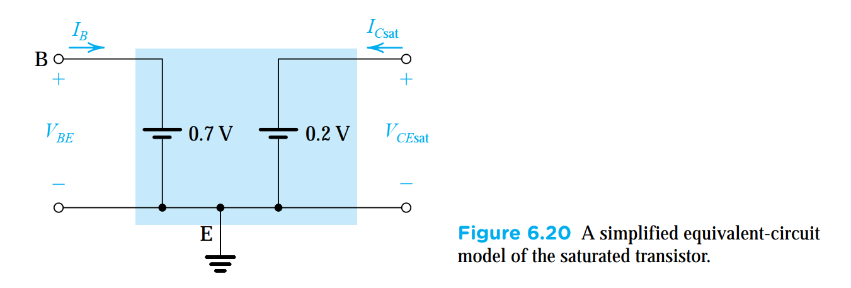
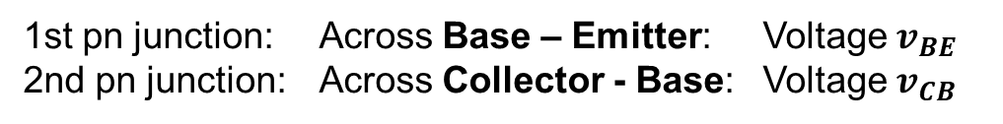
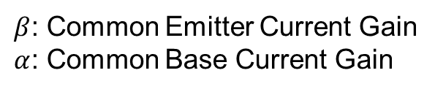

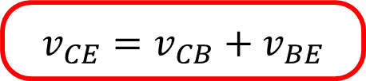
Parameters of BJT: Saturation Mode
Equivalent circuit of an npn-BJT in Saturation Mode
Current relationships between the three currents in an npn BJT.
$$I_{B}+I_{C}=I_{E}$$
$$I_{C(sat)}<βI_{B}$$
$$I_{C}≠αI_{E}$$
$β$: Common Emitter Current Gain
$α$: Common Base Current Gain
Only valid for Saturation mode
1st pn junction: Across Base – Emitter: Voltage $v_{BE}$
2nd pn junction: Across Collector - Base: Voltage $v_{CB}$
$$v_{CE}=v_{CB}+v_{BE}$$

Slide 17



Parameters of BJT
A BJT can be thought of as two “pn” junctions placed back-to-back.
Modes | Conditions!
Cut-off | $v_{BE}<0.7 V$and $v_{CB}>−0.5 V$
Active | $v_{BE}=0.7 V$ and $v_{CE}>0.2 V$
Saturation | $v_{BE}=0.7 V$ and $v_{CE}=0.2 V$ and $\frac{I_{C}}{I_{B}}<β$
Reverse Active | $v_{BC}=0.5 V$ and $v_{EC}>0.2 V$
1st pn junction: Across Base – Emitter: Voltage $v_{BE}$
2nd pn junction: Across Collector - Base: Voltage $v_{CB}$
$$v_{CE}=v_{CB}+v_{BE}$$

Slide 18

Solving Circuits with MOSFET BJT
Use Method of Assumed State!
Three steps:
Assume: One of the modes
(Cutoff, Triode Saturation, Saturation Active)
Solve: Use corresponding equation and KCL + KVL with currents
Verify: Check if the conditions of $V_{GS}$ $v_{BE}$ and $V_{DS}$ $v_{CE}$ are satisfied. If not, repeat.
Might need to solve quadratic equation ($ax^{2}+bx+c = 0$).
If we get two roots, choose the one that’s favorable to your assumption

Slide 19




MOSFET Problem 1
Analyze the circuit to find $i_{D}$ and $v_{O2}$ using the Method of Assumed State. Here, the input of the MOSFET is $v_{o1}=1 V$. You must validate your assumptions.
Assume: One of the modes (Cutoff, Triode, Saturation)
Let the MOSFET be in SATURATION
Solve: corresponding equations:
Equation: $i_{D}=\frac{2−v_{o2}}{1}=\frac{k}{2}{\left(v_{o1}−V_{T}\right)}^{2}$
Solving Equations $→$
$v_{o2}=2−\frac{4}{2}{\left(1−0.2\right)}^{2} V$
$v_{o2}=\left(2−1.28 \right)V=0.72 V$
Verify: For saturation condition $→$ $v_{DS}>v_{GS}−V_{T}$
Here, $v_{GS}−V_{T}=\left(1−0.2\right) V=0.8 V$
$v_{DS}=v_{o2}=0.72 V ≯0.8 V$
Assumption is Wrong!
$$v_{o1}=1 V$$

Slide 20


MOSFET Problem 1
Analyze the circuit to find $i_{D}$ and $v_{O2}$ using the Method of Assumed State. Here, the input of the MOSFET is $v_{o1}=1 V$. You must validate your assumptions.
Assume:
Let the MOSFET be in TRIODE
Solve:
Equation: $i_{D}=\frac{2−v_{o2}}{1}=k\left(v_{o1}−V_{T}−\frac{v_{o2}}{2}\right)v_{o2}$
Solving Equations $→$
${2−v}_{o2}=4\left(0.8−\frac{v_{o2}}{2}\right)v_{o2}$
${2v}_{o2}^{2}−4.2v_{o2}+2=0$
$v_{o2}=1.37 V or 0.73 V$
Verify: For triode condition $→$ $v_{DS}<v_{GS}−V_{T}$
Here, $v_{GS}−V_{T}=\left(1−0.2\right) V=0.8 V$
$v_{DS}=v_{o2}=0.73 V<0.8 V$
Assumption is Correct!
$$v_{o1}=1 V$$

Slide 21





BJT Problem 1
Analyze the circuit to find $I_{C}$ and $v_{out}$ using the Method of Assumed State. Here, the input of the BJT is $V_{i}=1 V$. You must validate your assumptions.
Assume:
Let the BJT be in ACTIVE mode
So, $v_{BE}=0.7 V$
$v_{CE}>0.3 V$
Solve:
Equations: $I_{B}=\frac{V_{i}−v_{BE}}{R_{B}}=\frac{1−0.7}{100} mA=3 μA$
$I_{C}=βI_{B}=100×3×{10}^{−3} mA=0.3 mA$
$v_{out}=10−I_{C}R_{C}=\left(10−0.3×3 \right) V=9.1 V$
$$β=100$$
Verify: For ACTIVE condition $→$ $v_{CE}>0.3 V$
Here, $v_{CE}=v_{out}=9.1 V>0.3 V$
Assumption is Correct!

Slide 22



BJT Problem 1
Analyze the circuit to find $I_{C}$ and $v_{out}$ using the Method of Assumed State. Here, the input of the BJT is $V_{i}=5 V$. You must validate your assumptions.
Assume:
Let the BJT be in ACTIVE mode
So, $v_{BE}=0.7 V$
$v_{CE}>0.2 V$
Solve:
Equations: $I_{B}=\frac{V_{i}−v_{BE}}{R_{B}}=\frac{5−0.7}{100} mA=43 μA$
$I_{C}=βI_{B}=100×43×{10}^{−3} mA=4.3 mA$
$v_{out}=10−I_{C}R_{C}=\left(10−4.3×3 \right) V=−2.9 V$
$$β=100$$
Verify: For ACTIVE condition $→$ $v_{CE}>0.2 V$
Here, $v_{CE}=v_{out}=−2.9 V≯0.2 V$
Assumption is Wrong!

Slide 23




BJT Problem 1
Analyze the circuit to find $I_{C}$ and $v_{out}$ using the Method of Assumed State. Here, the input of the BJT is $V_{i}=5 V$. You must validate your assumptions.
Assume:
Let the BJT be in Saturation mode
So, $v_{BE}=0.7 V$ and $\frac{I_{C}}{I_{B}}<β$
$v_{CE}=0.2 V$
Solve:
Equations: $I_{B}=\frac{V_{i}−v_{BE}}{R_{B}}=\frac{5−0.7}{100} mA=43 μA$
$I_{C}=βI_{B} \frac{10−v_{CE}}{R_{C}}=\frac{10−0.2}{3}mA=3.27 mA$
$v_{out}=v_{CE}=0.2 V$
$$β=100$$
Verify: For Saturation condition $→$ $\frac{I_{C}}{I_{B}}<β$
Here, $β=100$ $\frac{I_{C}}{I_{B}}=\frac{3.27}{0.043}=76<100$
Assumption is Correct!

Slide 24





BJT Problem 2
Analyze the circuit to find $I_{B}, I_{C}, I_{E}$ and $v_{out}$ using the Method of Assumed State. You must validate your assumptions.
Assume:
Let the BJT be in Active mode
So, $v_{BE}=0.7 V$
$v_{CE}>0.2 V$
$$v_{E}=−0.7 V$$
$$β=100$$
Solve:
Equations: $I_{E}=\frac{v_{E}−(−10)}{10}=\frac{−0.7+10}{10}mA=0.93 mA$
$I_{B}=\frac{1}{β}I_{C}=\frac{1}{β}⋅αI_{E}=\frac{1}{β}⋅\frac{β}{β+1}I_{E}=\frac{1}{β+1}I_{E}=9.21 μA$
$v_{out}=v_{C}=10−{3I}_{C}=10−3βI_{B}$
$=\left(10−3⋅100⋅9.207×10^{−3}\right)V$
$=7.237 V$

Slide 25






BJT Problem 2
Analyze the circuit to find $I_{B}, I_{C}, I_{E}$ and $v_{out}$ using the Method of Assumed State. You must validate your assumptions.
Assume:
Let the BJT be in Active mode
So, $v_{BE}=0.7 V$
$v_{CE}>0.2 V$
$$+$$
$$v_{CE}$$
$$β=100$$
Solve:
Equations: $I_{E}=0.93 mA$
$I_{B}=9.21 μA$
$v_{out}=v_{C}=7.237 V$ $v_{B}=0 V$ $v_{E}=−0.7 V$
$$−$$
Verify: For ACTIVE condition $→$ $v_{CE}>0.2 V$
Here, $v_{CE}=\left(7.237+0.7\right) V=7.937 V>0.2 V$
Assumption is Correct!

